Slide 1
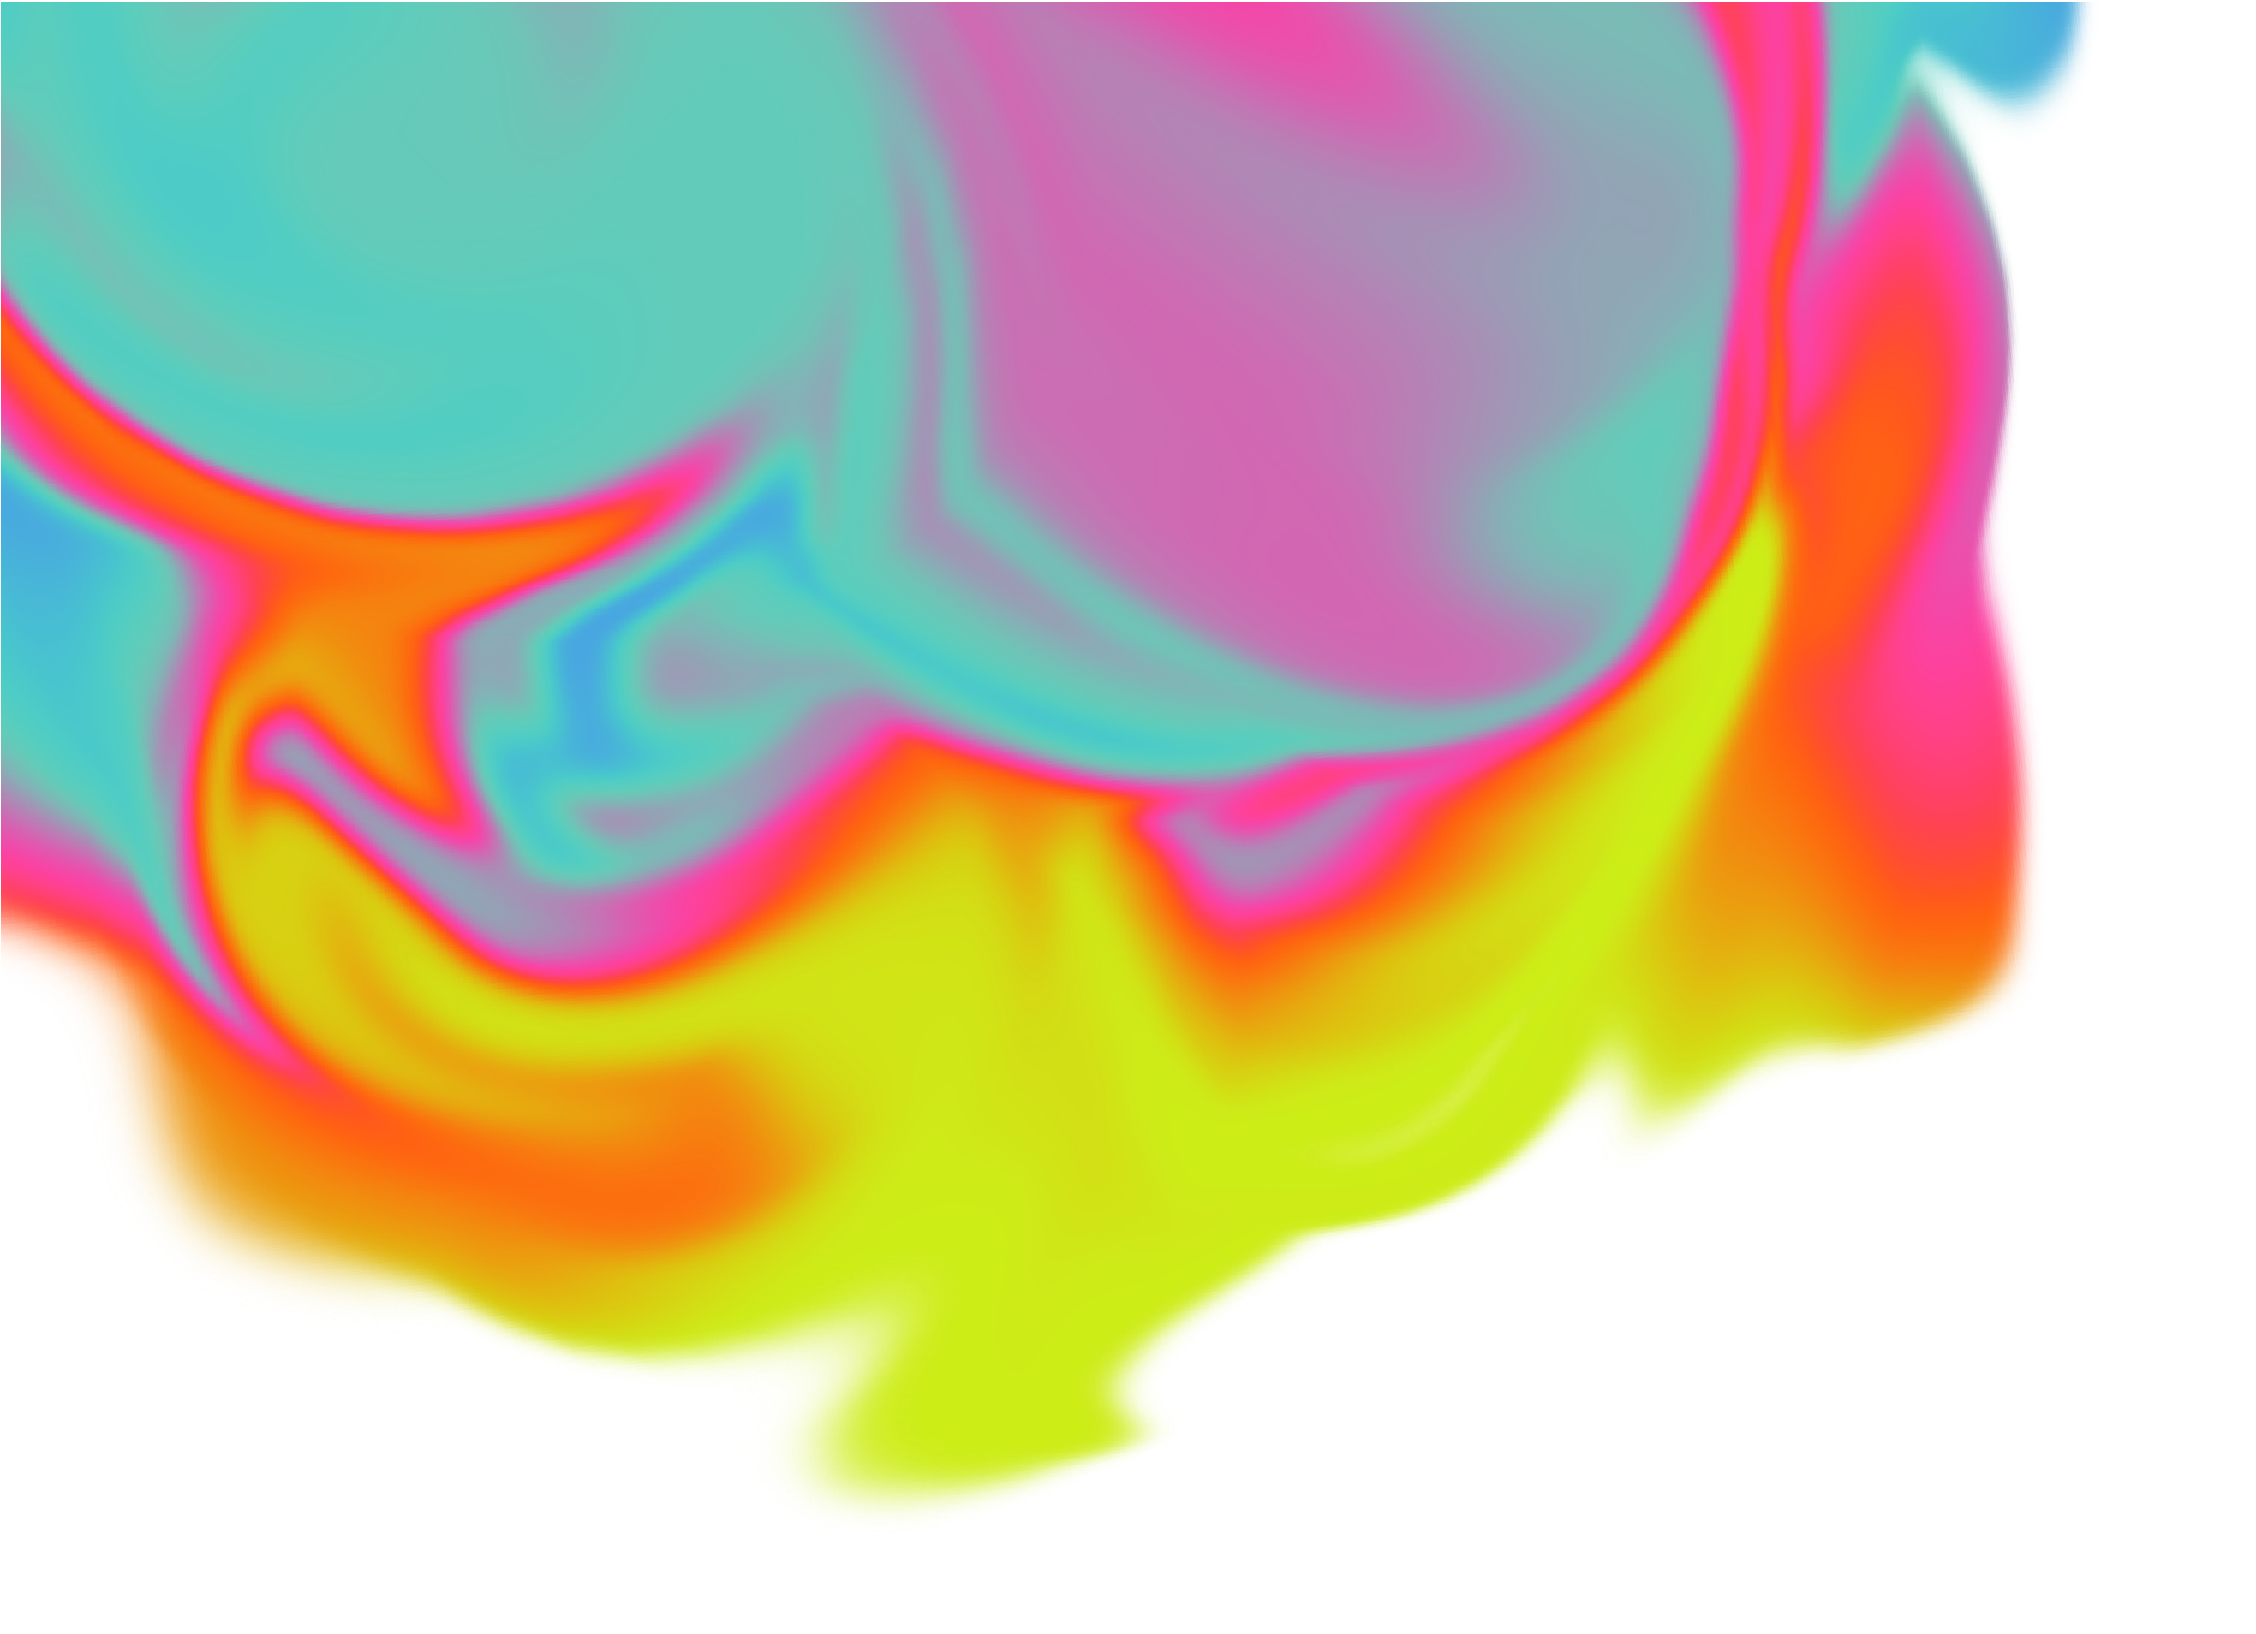
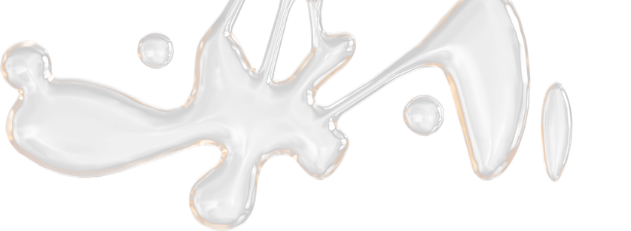
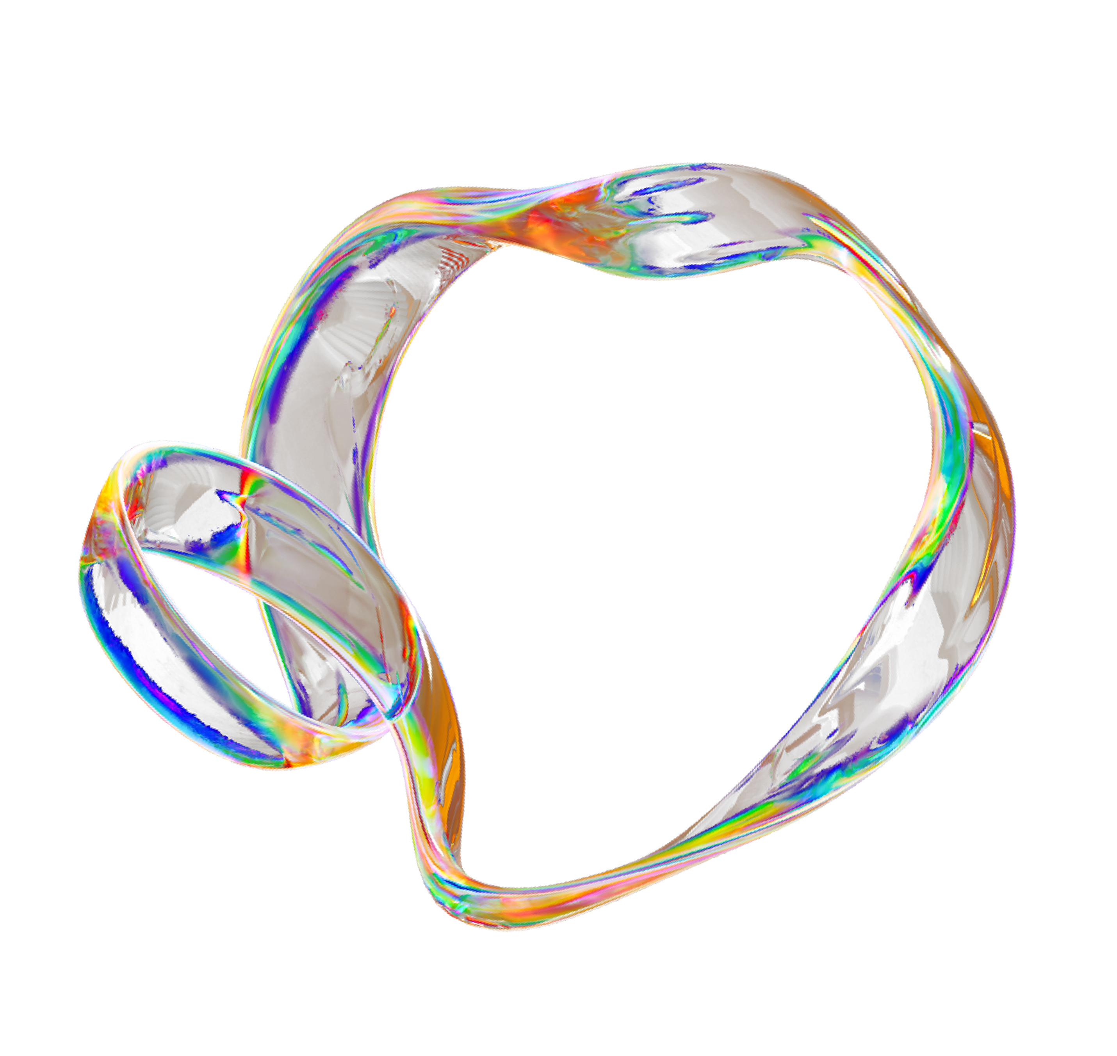


Java Ray Tracer
B R A N D O N
M A G A Ñ A
A V A L O S
UNIVERSIDAD
PANAMERICANA

Slide 2

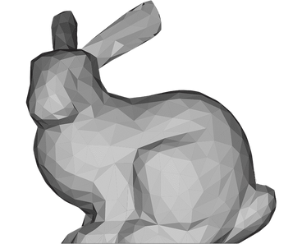
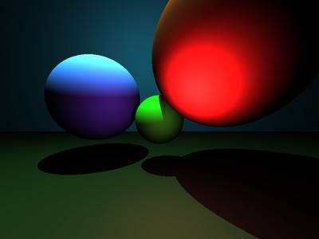
WHAT IS A RAY TRACER?
A method of graphics rendering that simulates the physical behavior of light, shadows, refraccion, and reflections
OBJECTS
LIGHT
AND SHADOWS

Slide 3
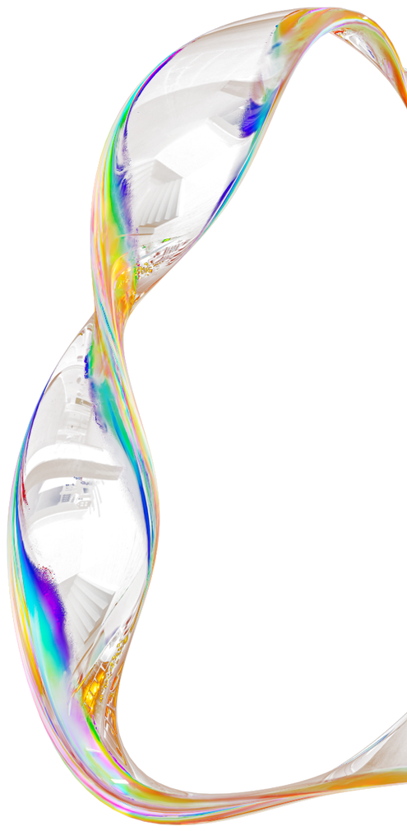

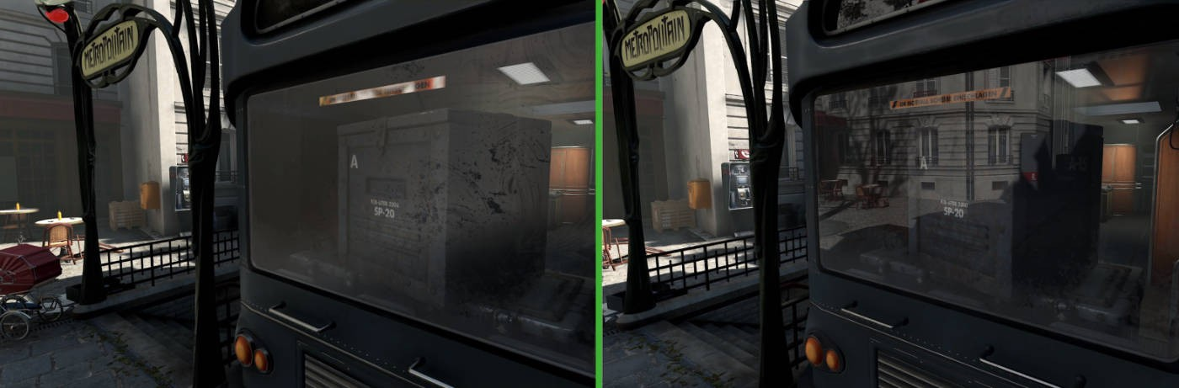
WHY?
For the same definition, it helps to give a touch of realism to things, makes them feel better and more interactive.
Or just give a better sensation of the objects.

Slide 4
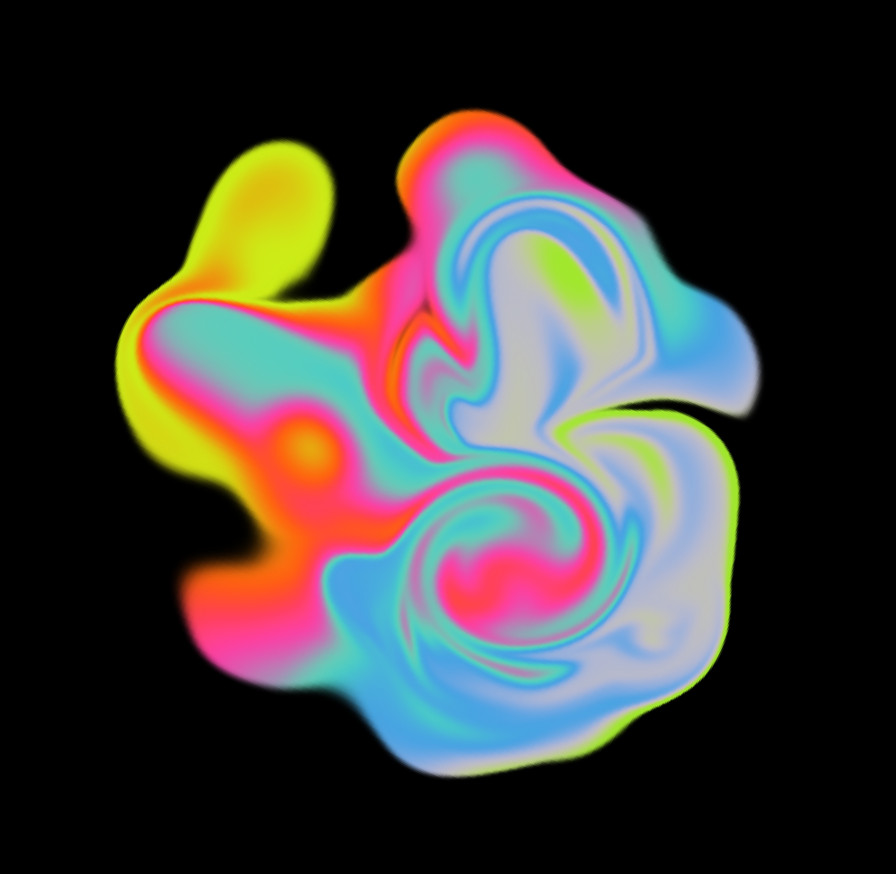

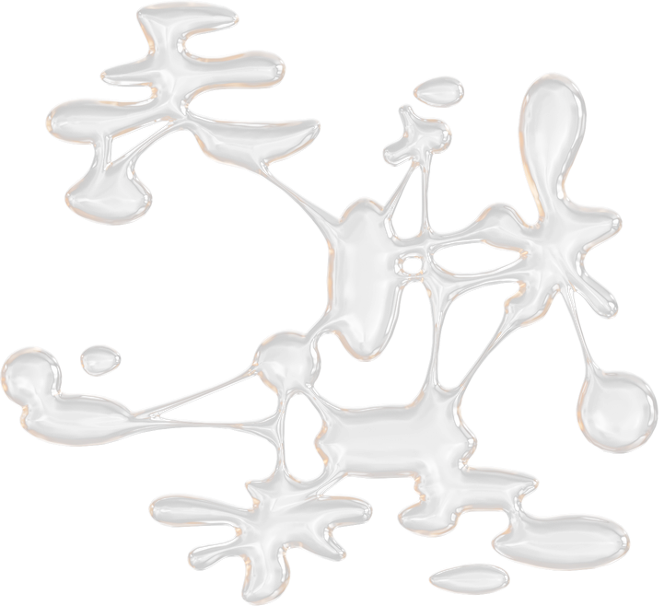
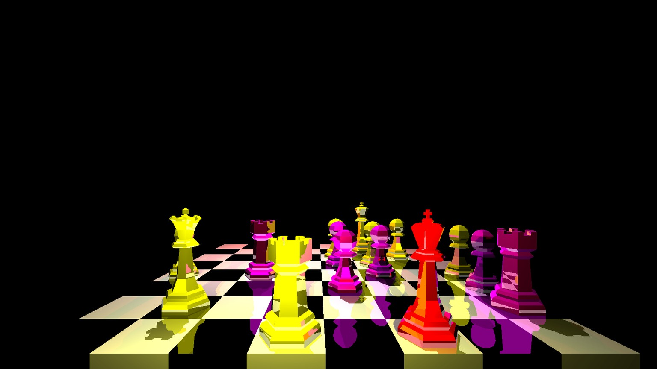
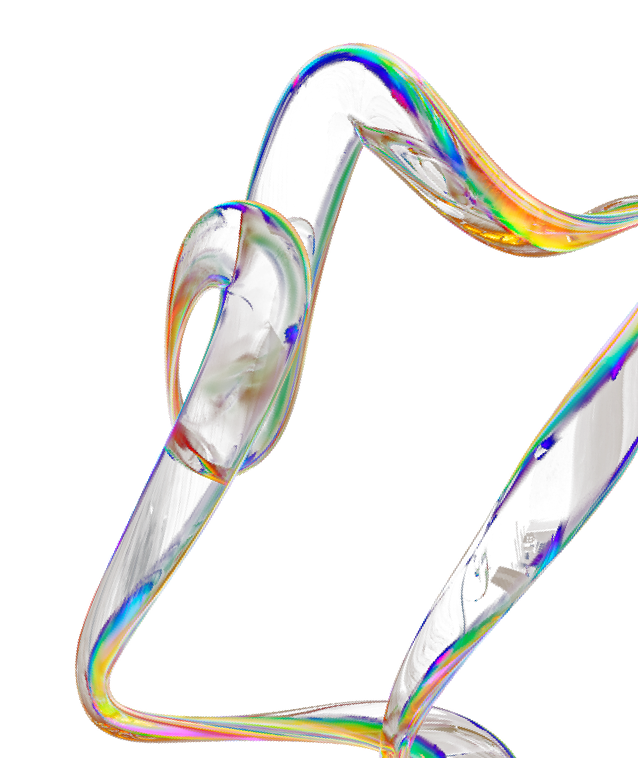

Slide 5
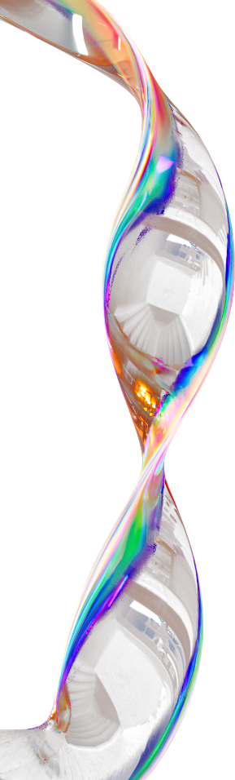

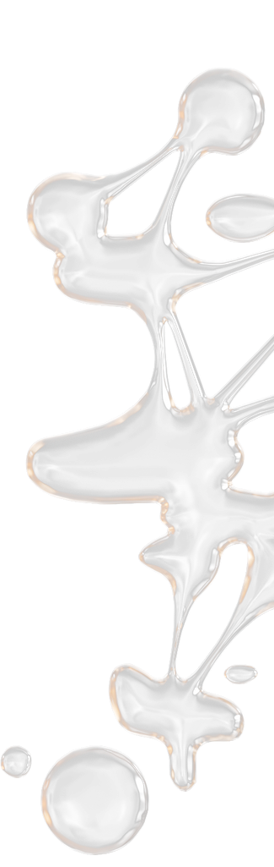
WHY MY RAY TRACER?
Fast
ser capaz de renderizar completamente imágenes complejas encuestión de minutos
Simple
Adding any object just by putting the file.obj and setting positions and coordinates
Customizable
Any object may or may not have refraction, reflection, brightness, and any color.

Slide 6
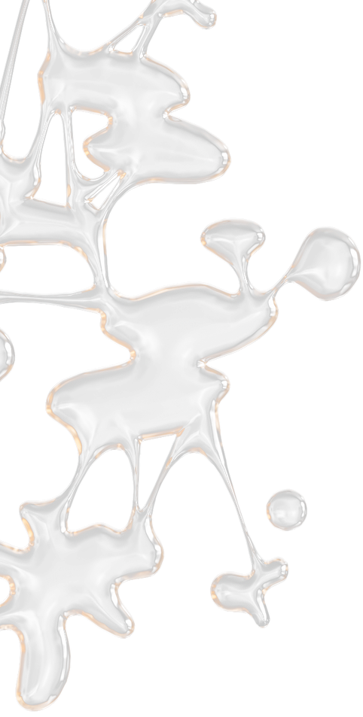
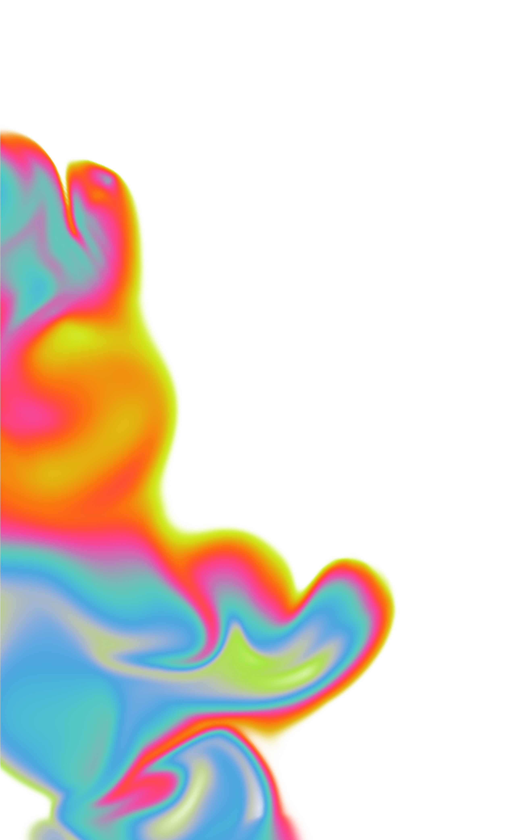
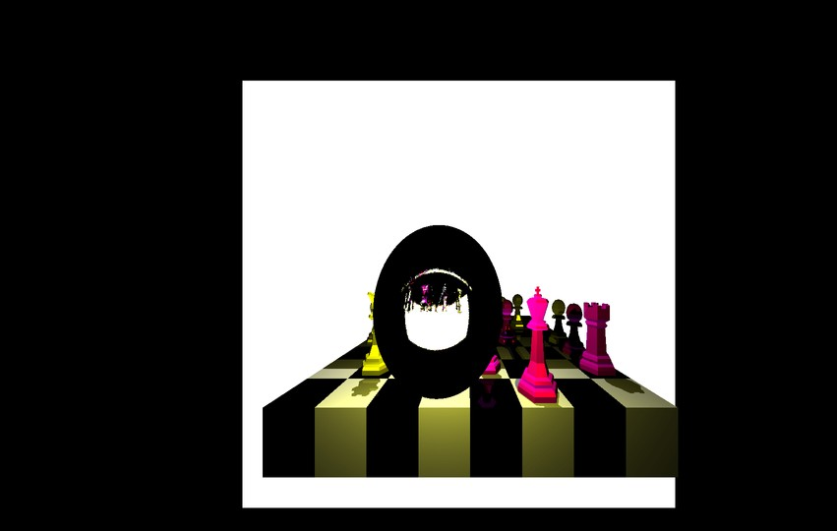
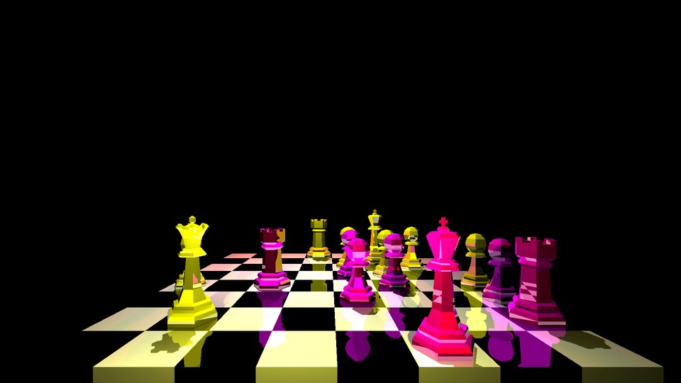
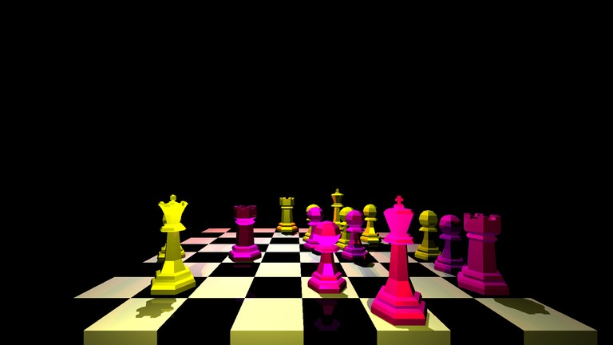
QUICK EXAMPLES (COMPLEX RENDERS 1080P)
3 minutes
6 minutes
9 minutes
ONE recursion in reflection
FOUR recursion in reflection
FOUR recursion in both refraccion and relfection

Slide 7
GET IT NOW

